Slide 1





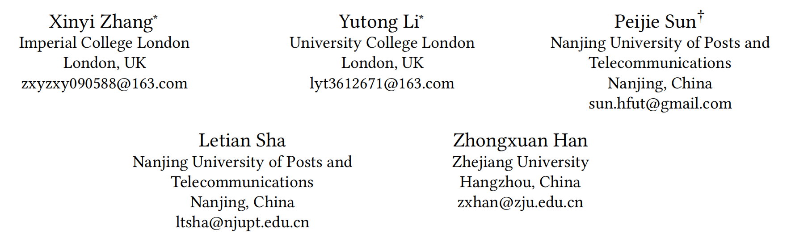





ATAI
Advanced Techniqueof Artificial Intelligence
ATAI
ChongqingUniversity _{AdvancedTechniqueof}
of Technology Artificial Intelligence
Chongqing University of
Technology
Chongqing University ^{ATAI}
_{of Technology} Advanced Techniqueof
Artificial Intelligence
Chongqing University of Technology
Chongqing University of Technology
PRISM: Personalized Recommendation via Information Synergy Module
Code: https://github.com/YutongLi2024/PRISM.
2026.2.1
—— WWW_2026
Reported by Yang Hu
1

Slide 2

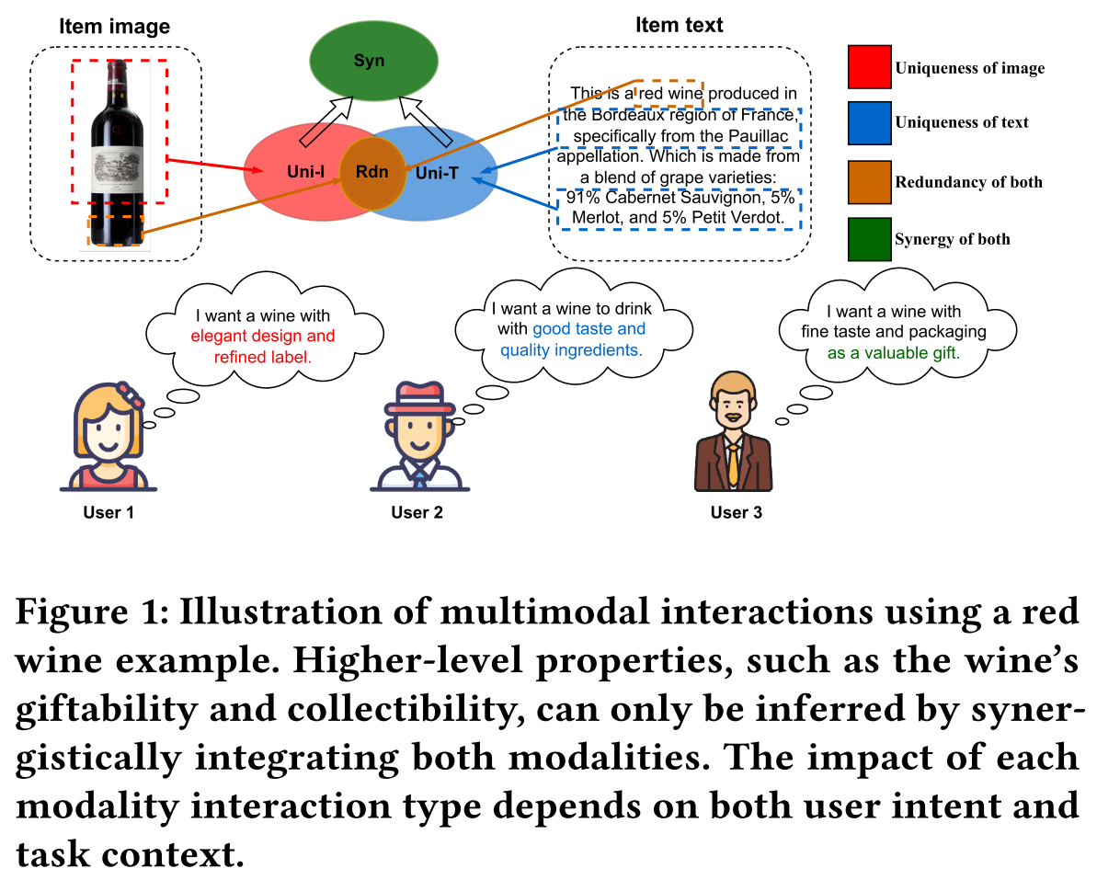
ATAI
AdvancedTechniqueof
Artificial Intelligence
ATAI
ChongqingUniversity _{AdvancedTechniqueof}
of Technology Artificial Intelligence
ChongqingUniversity of Technology
Motivation
Limitation 1: Existing methods fail to capture synergistic information that emerges only from the combination of modalities due to the lack of systematic modeling of multimodal interactions.
Limitation 2: Existing methods typically assume that the relative importance of modality interactions remains consistent across all users and recommendation scenarios, thereby overlooking user-specific preferences in utilizing multimodal information.

Slide 3

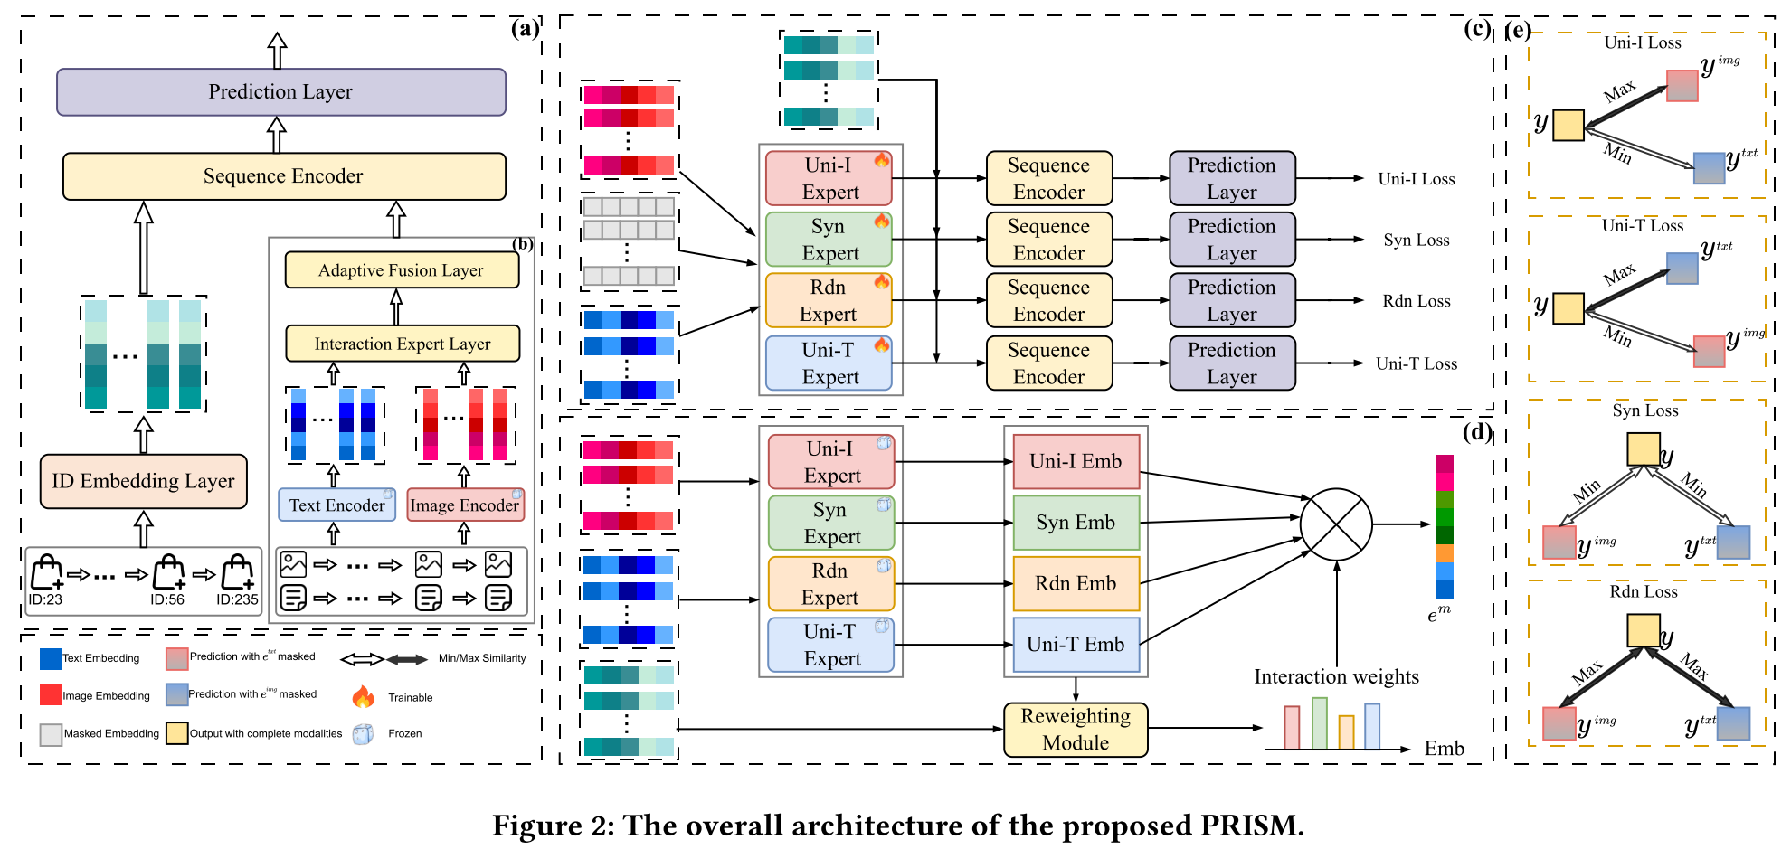
ChongqingUniversity of Technology
ATAI
AdvancedTechniqueof
Artificial Intelligence
ATAI
ChongqingUniversity _{AdvancedTechniqueof}
of Technology Artificial Intelligence
Overview

Slide 4
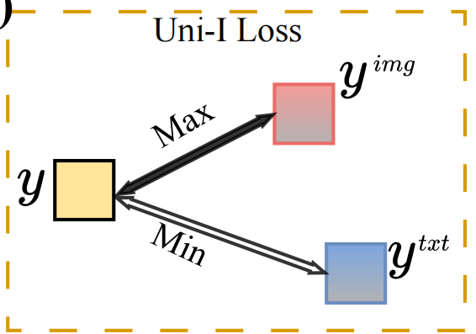
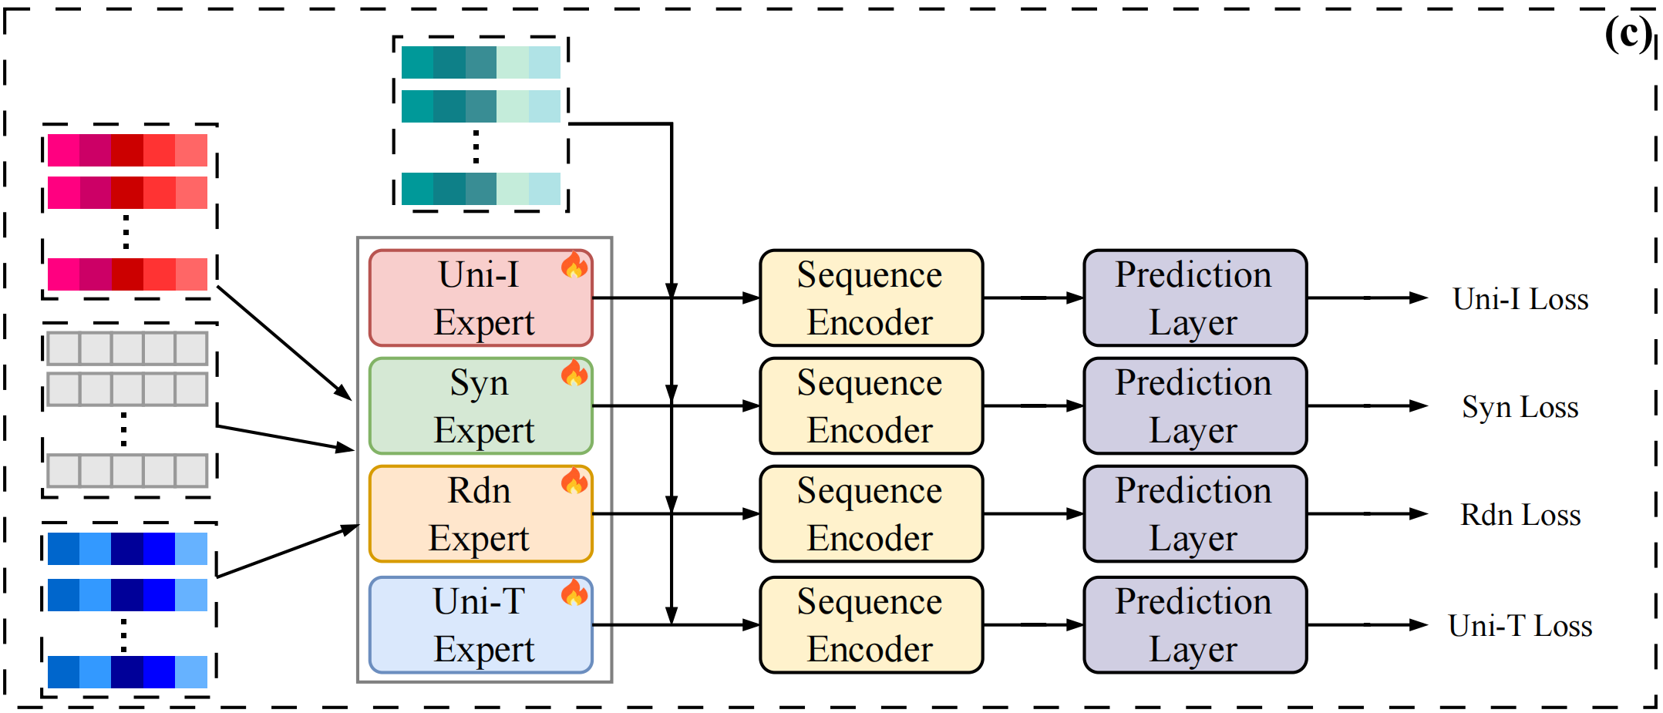


ChongqingUniversity of Technology
ATAI
AdvancedTechniqueof
Artificial Intelligence
ATAI
ChongqingUniversity _{AdvancedTechniqueof}
of Technology Artificial Intelligence
Method
(1)
(2)
(3)
(4)
(5)
(6)

Slide 5
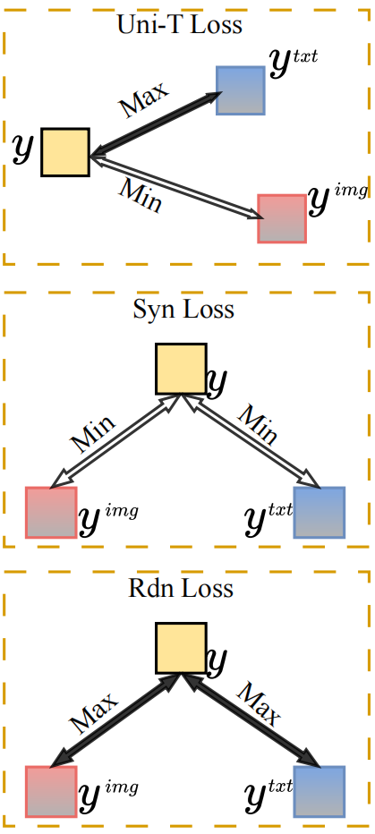
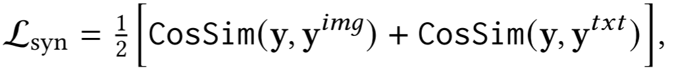
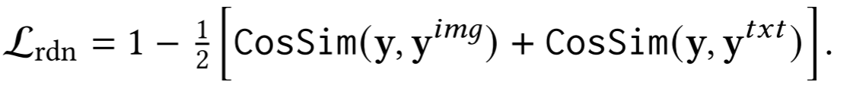
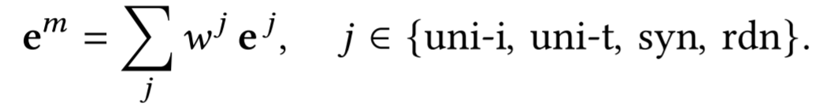
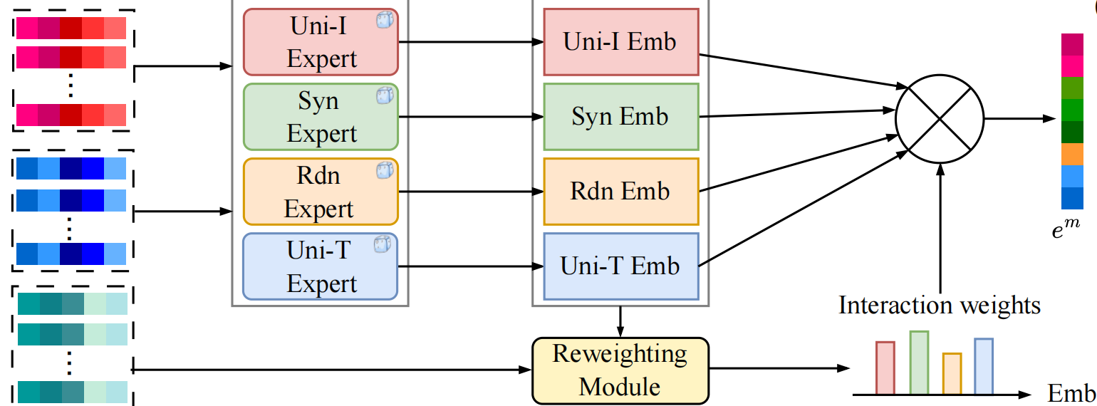
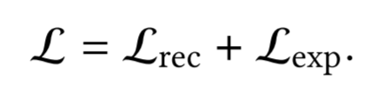
ChongqingUniversity of Technology
ATAI
AdvancedTechniqueof
Artificial Intelligence
ATAI
ChongqingUniversity _{AdvancedTechniqueof}
of Technology Artificial Intelligence
Method
(7)
(8)
(9)
(10)
(11)
(12)

Slide 6
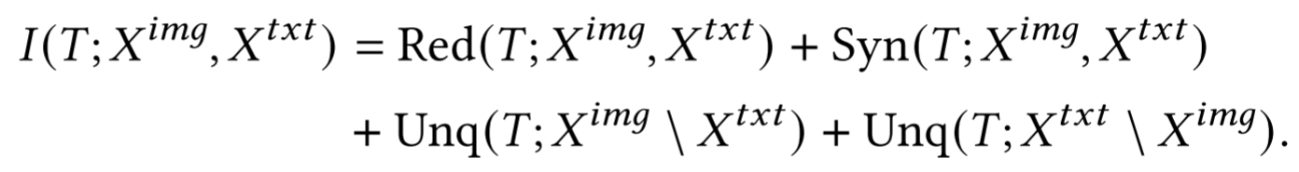



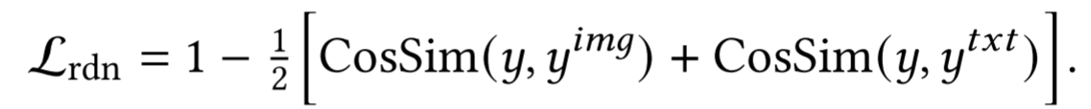

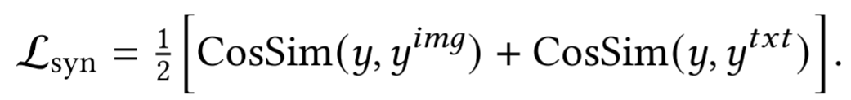

ChongqingUniversity of Technology
ATAI
AdvancedTechniqueof
Artificial Intelligence
ATAI
ChongqingUniversity _{AdvancedTechniqueof}
of Technology Artificial Intelligence
Method
(13)
(14)
(15)
(16)
(17)
(18)
(19)
(20)

Slide 7

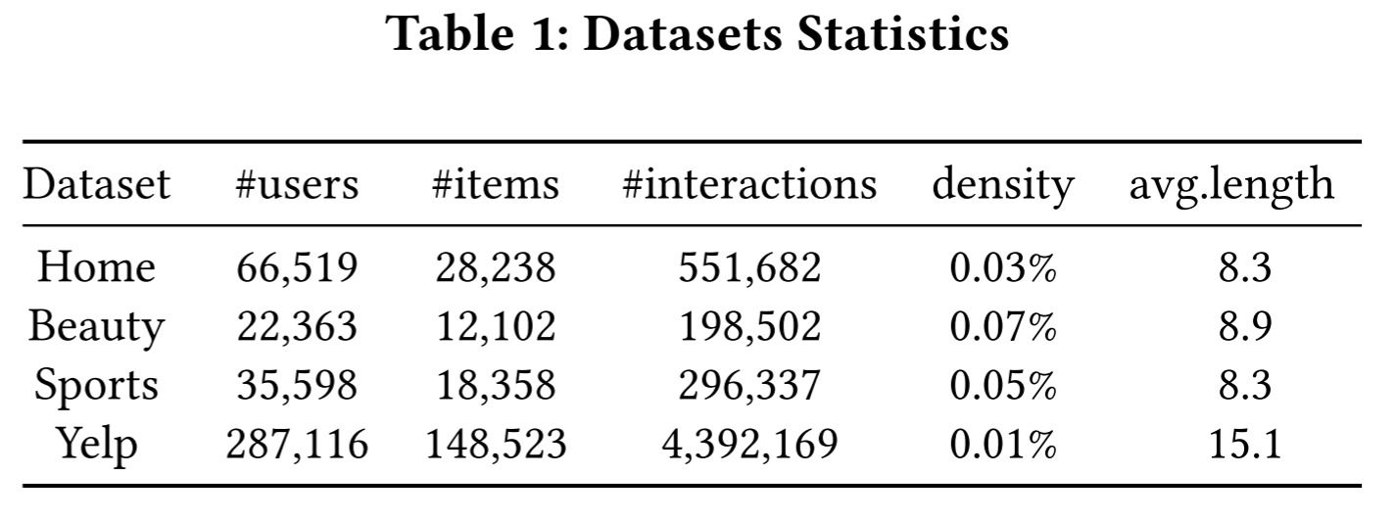
ATAI
AdvancedTechniqueof
Artificial Intelligence
ATAI
ChongqingUniversity _{AdvancedTechniqueof}
of Technology Artificial Intelligence
ChongqingUniversity of Technology
Experiments

Slide 8
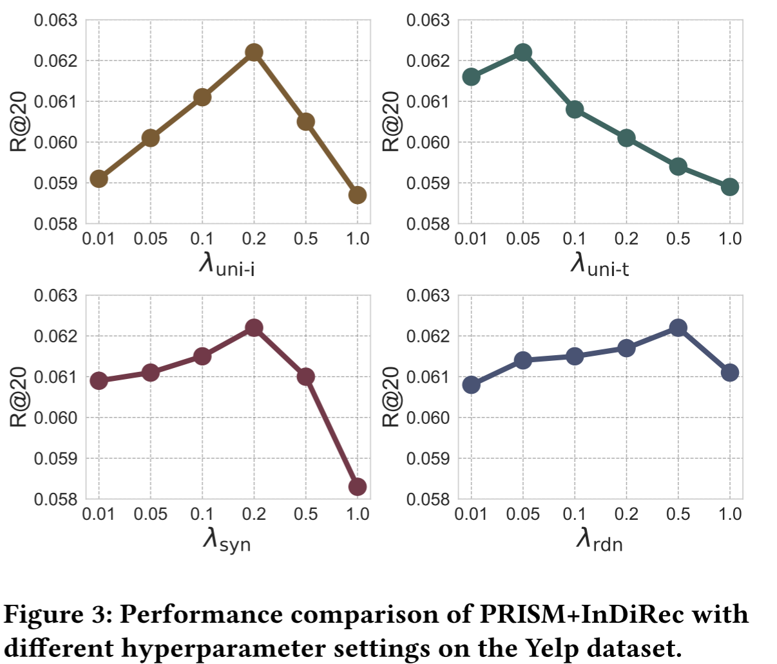
ATAI
AdvancedTechniqueof
Artificial Intelligence
ATAI
ChongqingUniversity _{AdvancedTechniqueof}
of Technology Artificial Intelligence
ChongqingUniversity of Technology
Experiments

Slide 9
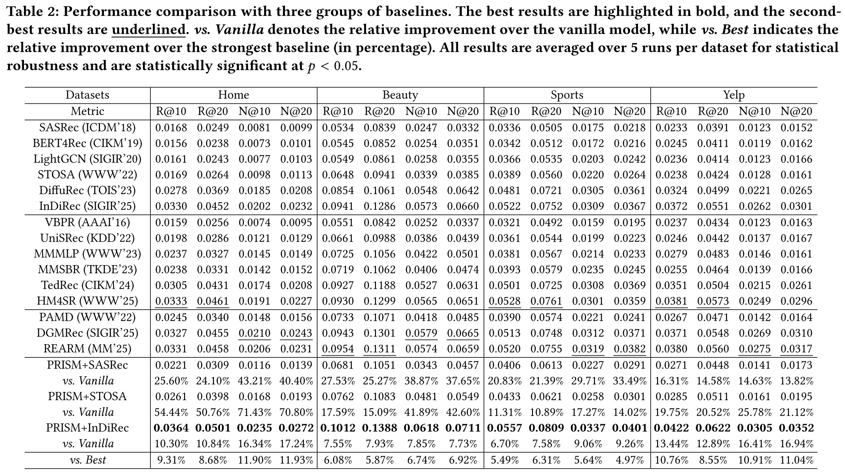
ATAI
AdvancedTechniqueof
Artificial Intelligence
ATAI
ChongqingUniversity _{AdvancedTechniqueof}
of Technology Artificial Intelligence
ChongqingUniversity of Technology

Slide 10
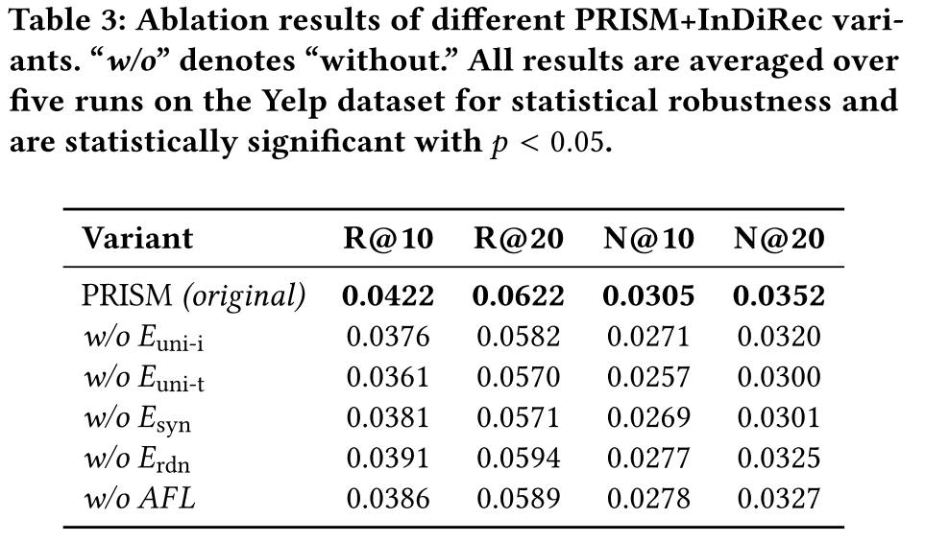
ATAI
AdvancedTechniqueof
Artificial Intelligence
ATAI
ChongqingUniversity _{AdvancedTechniqueof}
of Technology Artificial Intelligence
ChongqingUniversity of Technology
Experiments

Slide 11
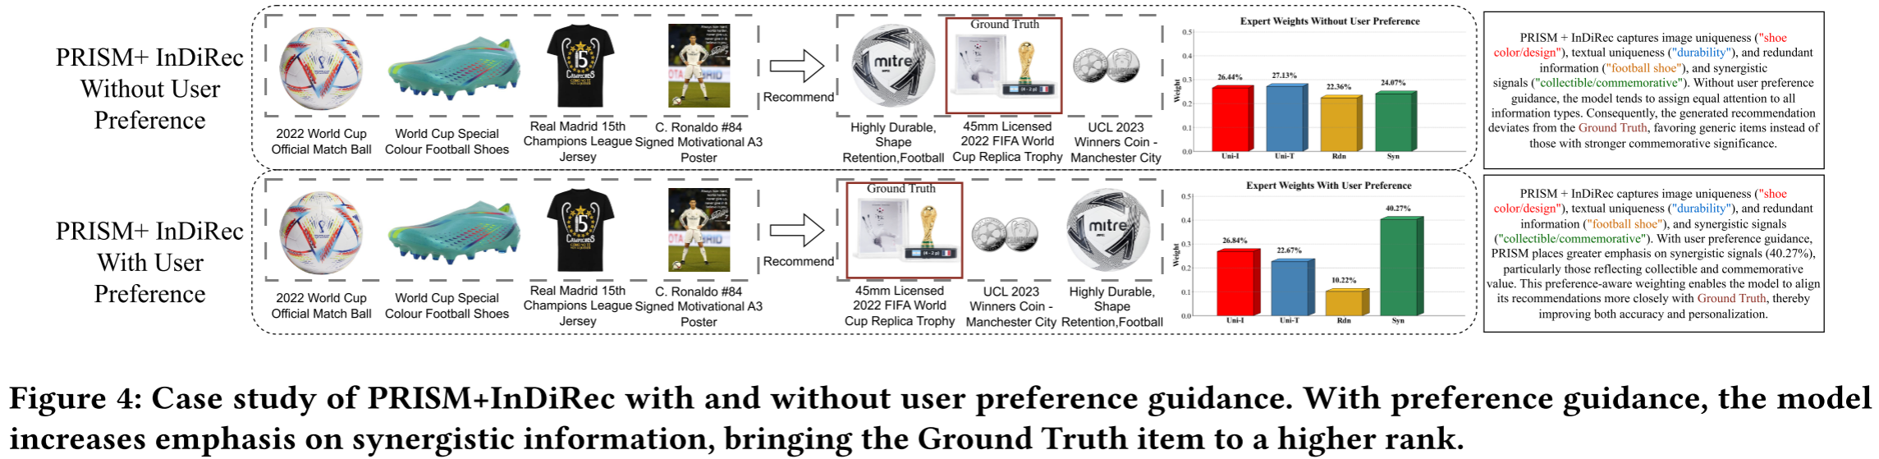
ATAI
AdvancedTechniqueof
Artificial Intelligence
ATAI
ChongqingUniversity _{AdvancedTechniqueof}
of Technology Artificial Intelligence
ChongqingUniversity of Technology
Experiments

Slide 12
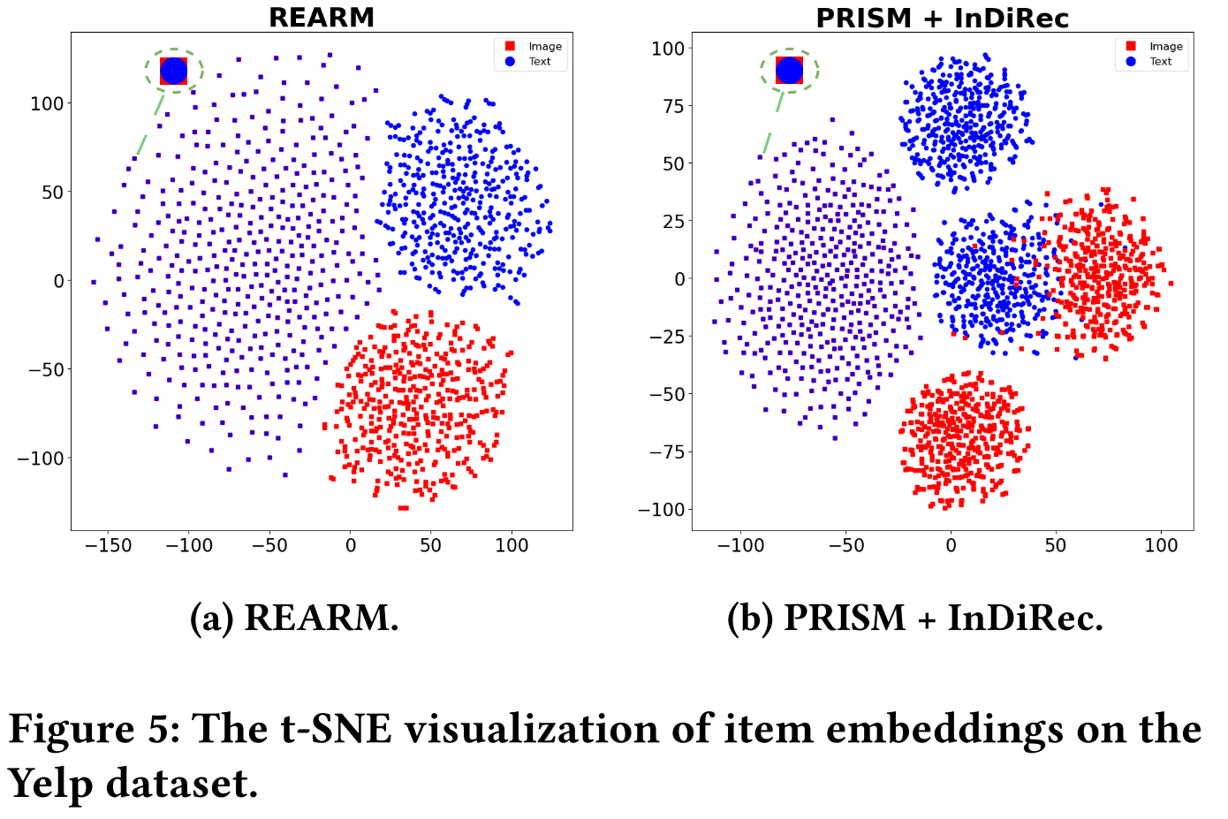
ATAI
AdvancedTechniqueof
Artificial Intelligence
ATAI
ChongqingUniversity _{AdvancedTechniqueof}
of Technology Artificial Intelligence
ChongqingUniversity of Technology
Experiments

Slide 13
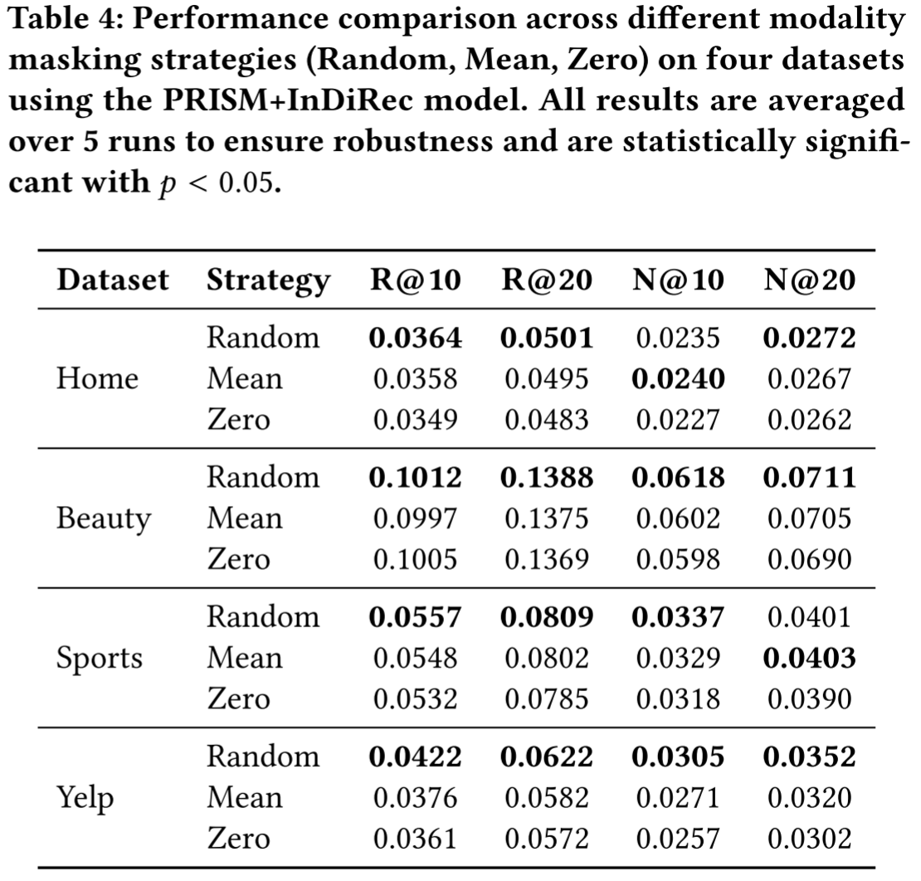
ATAI
AdvancedTechniqueof
Artificial Intelligence
ATAI
ChongqingUniversity _{AdvancedTechniqueof}
of Technology Artificial Intelligence
ChongqingUniversity of Technology
Experiments

Slide 14
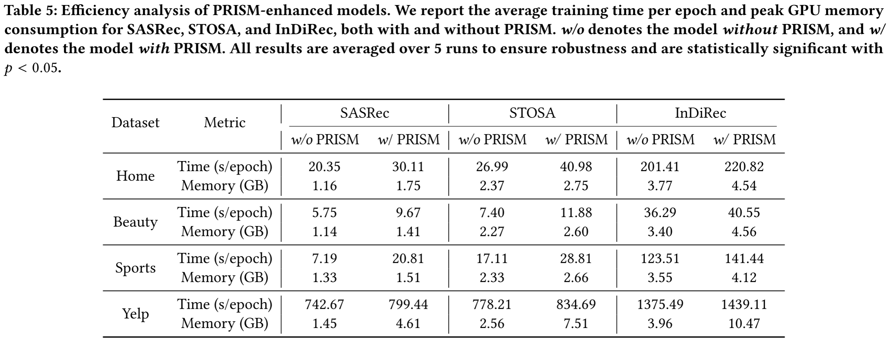
ATAI
AdvancedTechniqueof
Artificial Intelligence
ATAI
ChongqingUniversity _{AdvancedTechniqueof}
of Technology Artificial Intelligence
ChongqingUniversity of Technology
Experiments

Slide 15


ChongqingUniversity of Technology
ATAI
AdvancedTechniqueof
Artificial Intelligence
ATAI
ChongqingUniversity _{AdvancedTechniqueof}
of Technology Artificial Intelligence
Thanks!

